Slide 1

Sample-sequence-interpretation pipeline

Slide 2
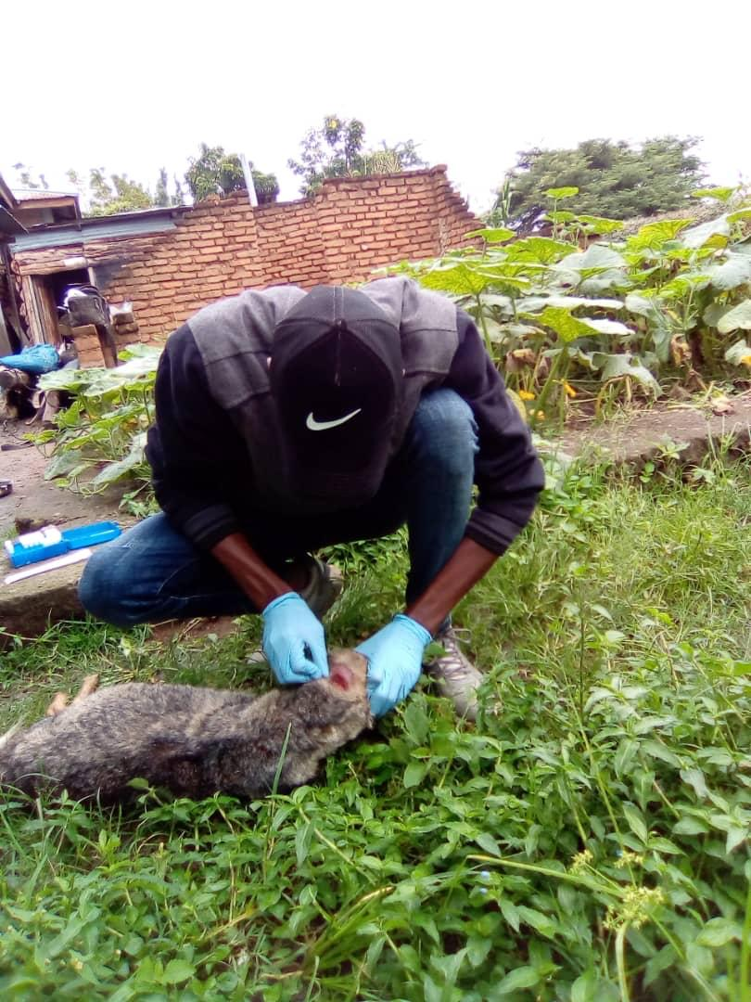
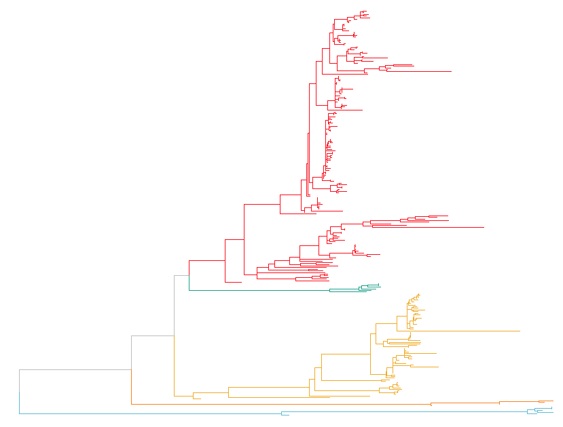
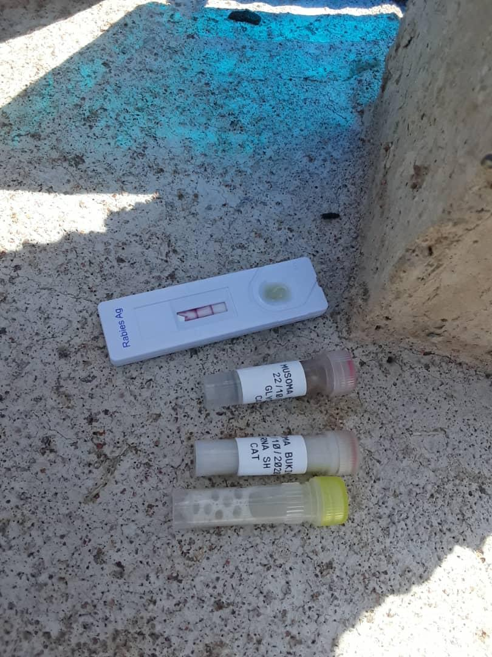
Sampling – Rabies samples
Sample collection (brain sample)+ rapid test is performed in the field
Molecular tech (PCR Sequencing - WGS)

Slide 3
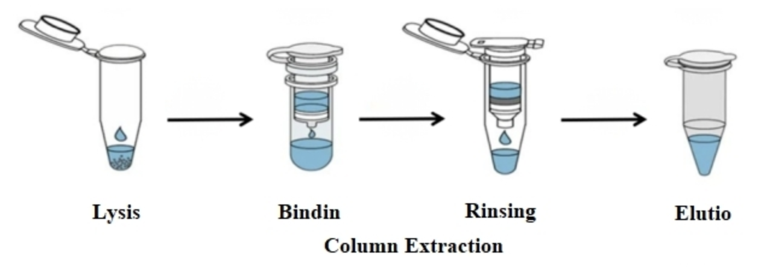
RNA-extraction – using zymo kit
Pure RNA

Slide 4
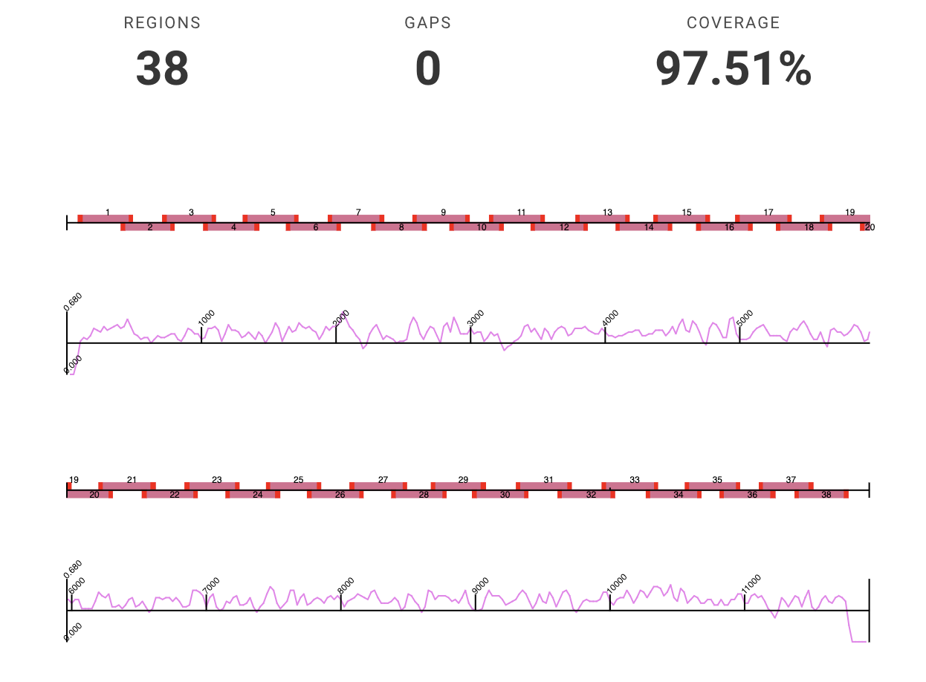
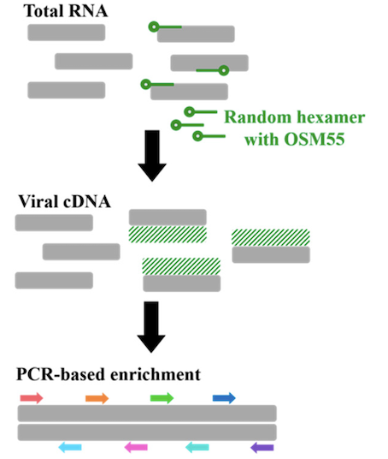
cDNA- multiplex PCR
Primal scheme– using tilling approach

Slide 5
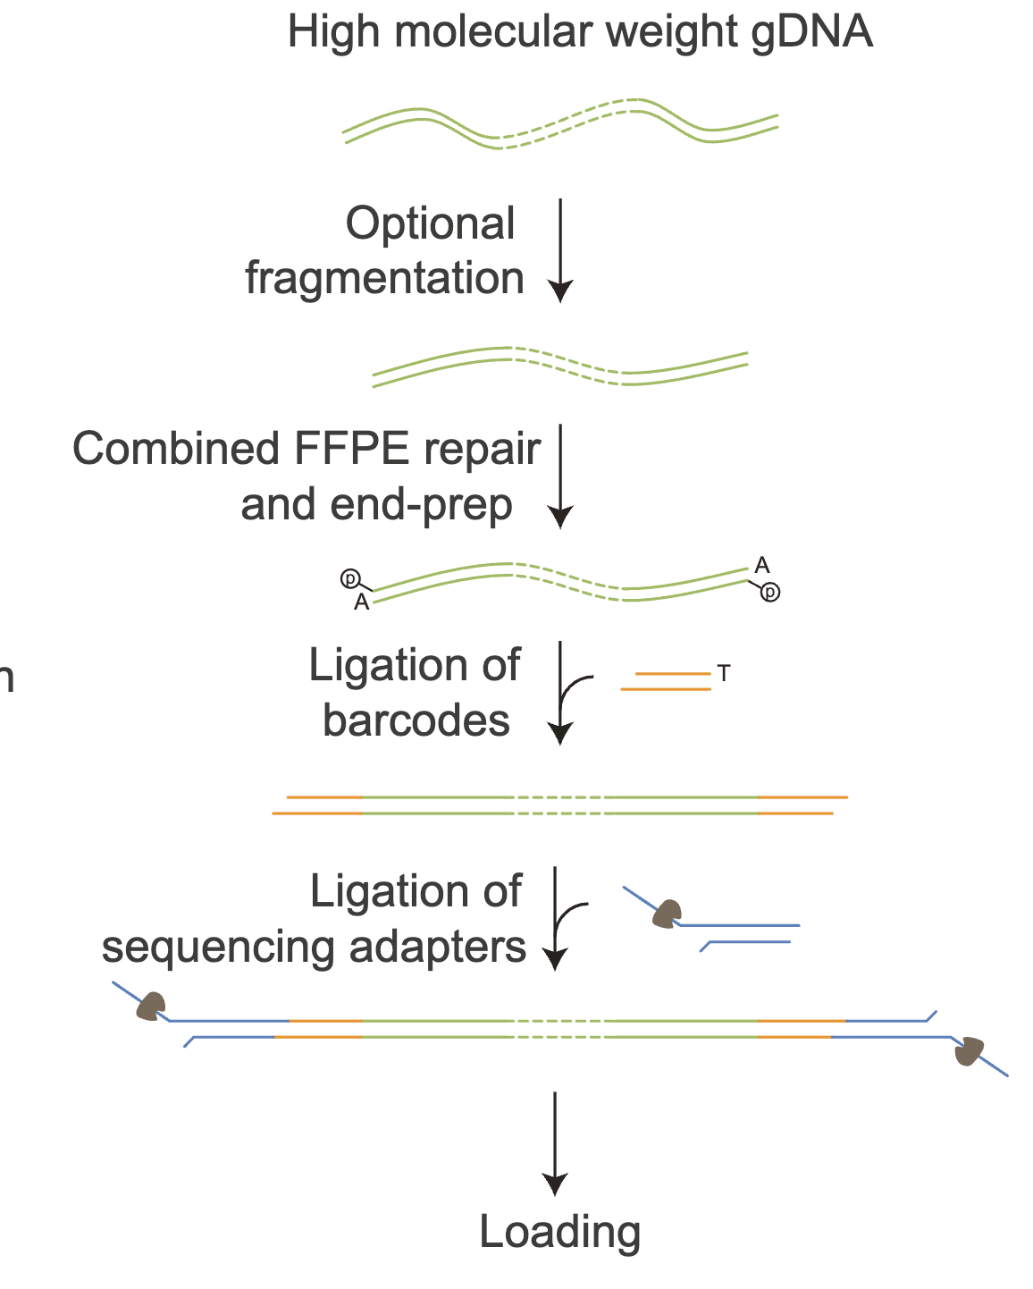
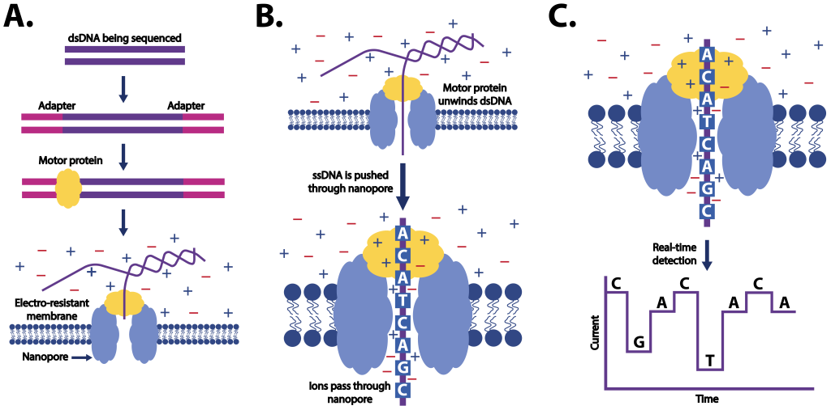
MinIon loading and sequencing

Slide 6
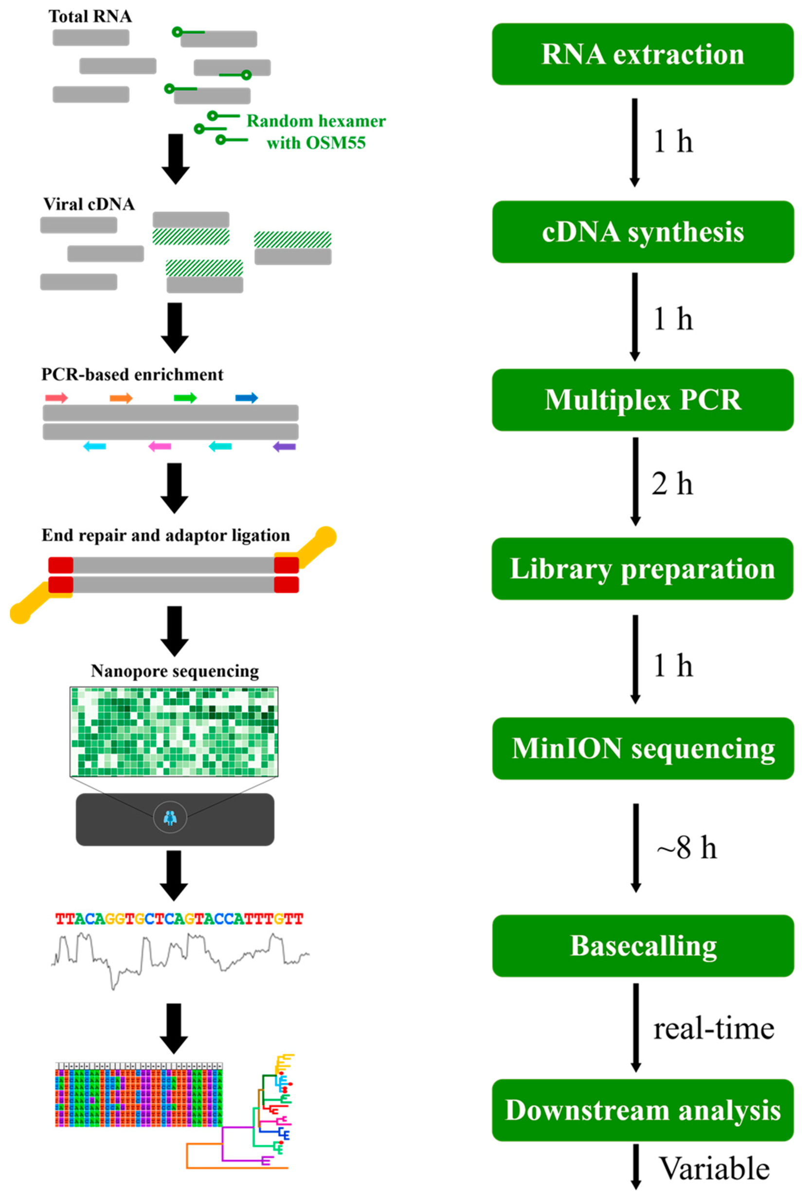
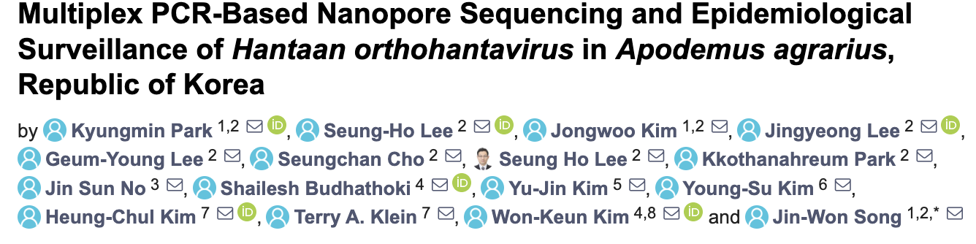
Summary

Slide 7
MinIon interpretation

Slide 8
Rampart- run

Slide 9
Consensus generation

Slide 10



Closing slide – You can add contact details, a call to action or a simple thank you
#UofGWorldChangers
@UofGlasgow

